Slide 1
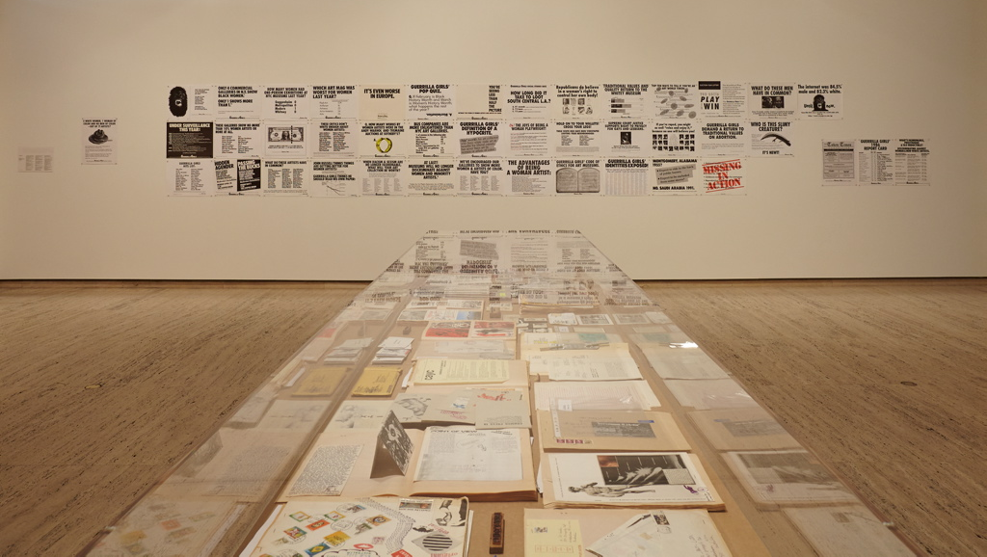

Slide 5
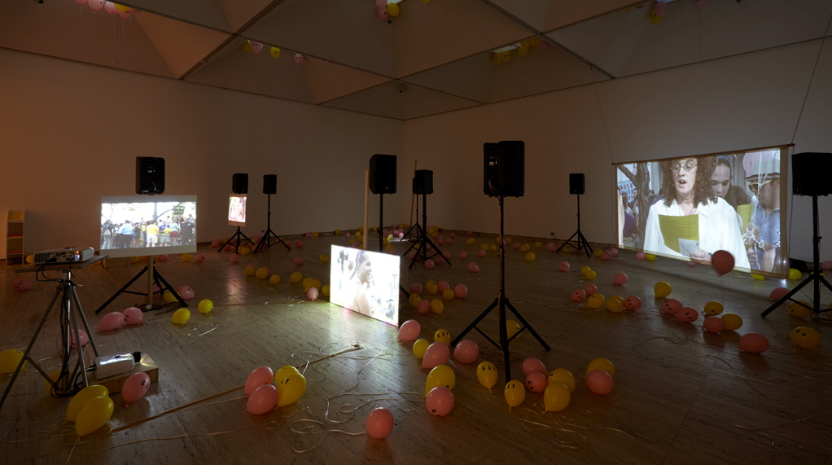

Slide 6
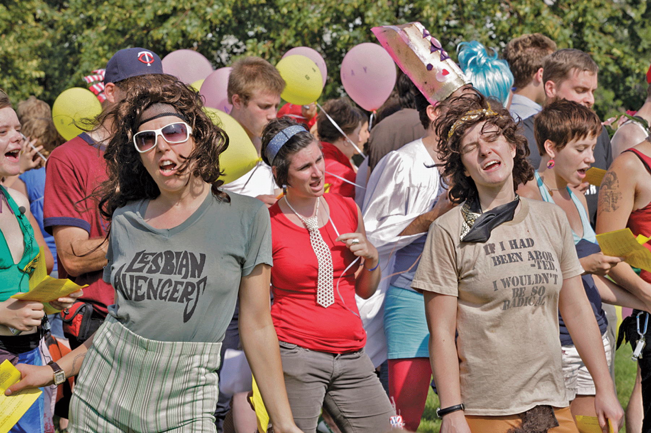

Slide 7
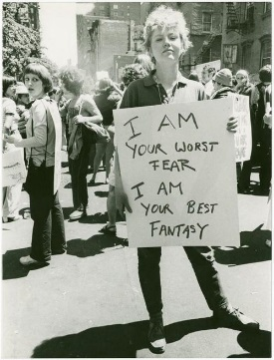
The whole project of archiving, of documenting that ‘we have a past’ is, in actuality, a desire for a future

